Slide 1
Quantum Mechanics for Electronic Structure II
Bulk and Periodic Solids
Yuan Ping
University of Wisconsin-Madison
Part of slides from lecture of Shobhana Narasimhan, JNCASR

Slide 2
Outline
First-principles calculation with periodic boundary condition (crystal)
Bravais lattice
Periodic boundary condition
Bloch theory and reciprocal space
Brillouin zone
Si crystal
SCF calculation
Band structure
Density of states

Slide 3
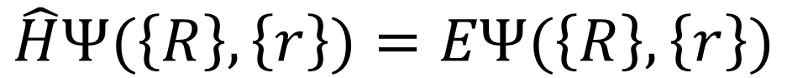
Density Functional Theory
Time-independent Schrödinger equation of multiple nuclei and electrons
Kohn-Sham equations of single electron:

Slide 4
We can solve a small molecule but…
10²³ atoms in 1cm³ solid material
Impossible to calculate directly!
Crystal : solid material arranged in an ordered structure
Utilize this condition to simplify the problem?
…

Slide 5
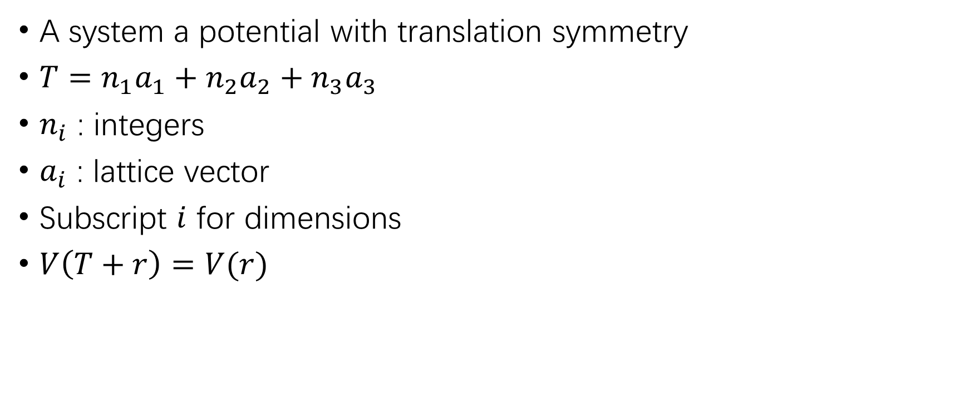
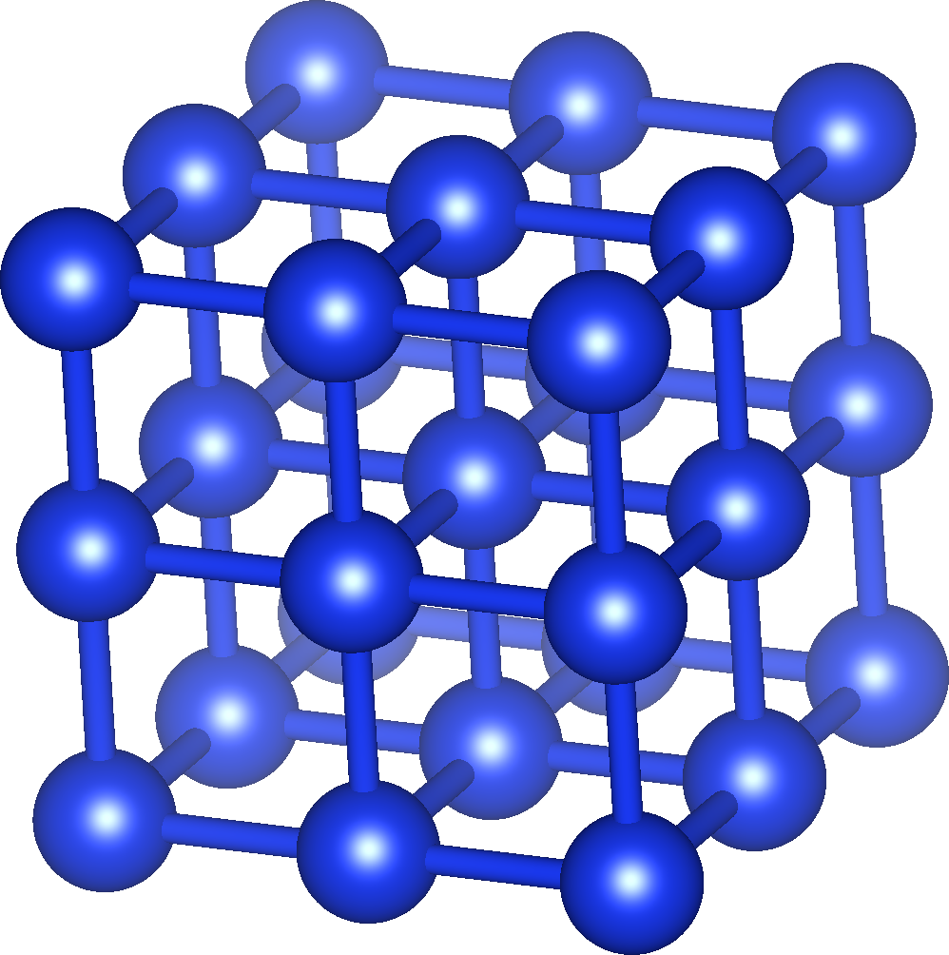
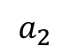
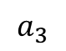
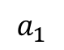
Bravais Lattice

Slide 6
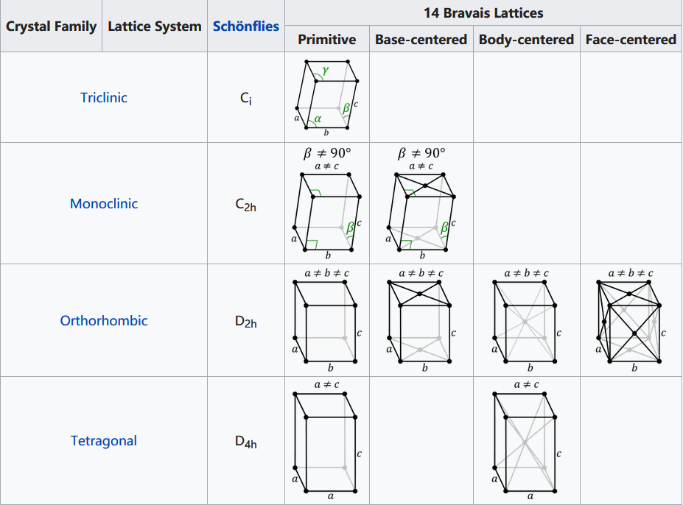
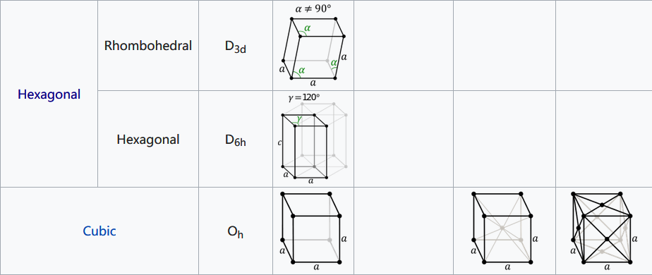
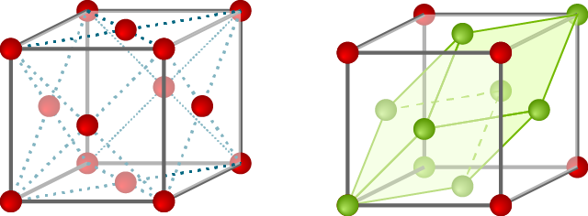
Bravais Lattice
Classified in 7 lattice system and 14 lattices according to symmetry
Centered cell can be further reduced to smaller primitive cell
Convention cell (FCC) Primitive cell (FCC)
https://www.physics-in-a-nutshell.com/article/11/close-packed-structures-fcc-and-hcp
https://en.wikipedia.org/wiki/Bravais_lattice

Slide 7
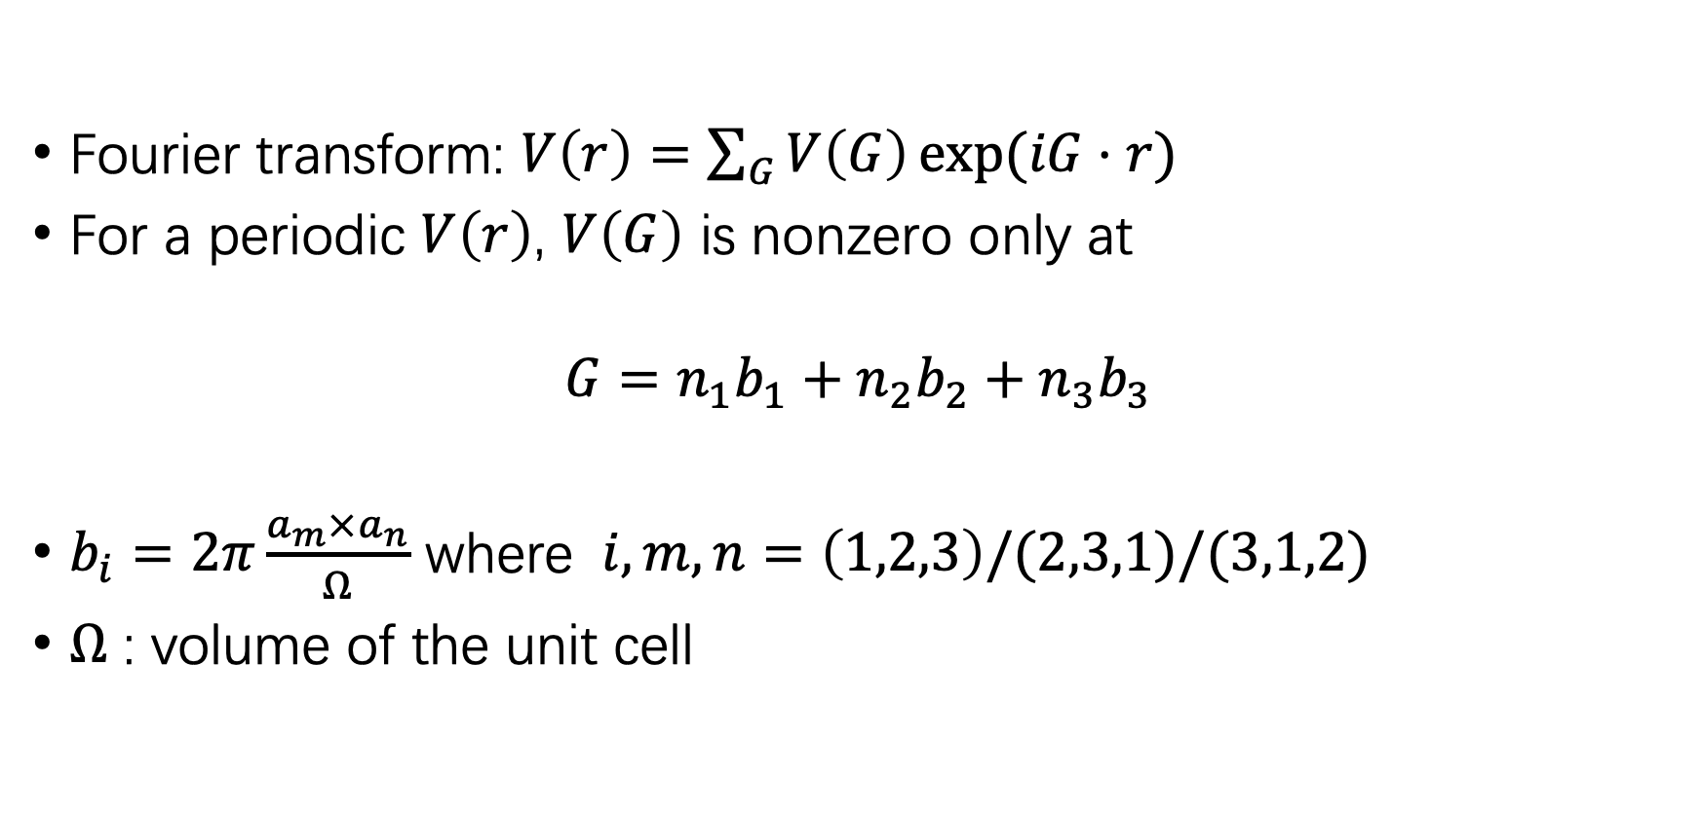
Reciprocal lattice

Slide 8
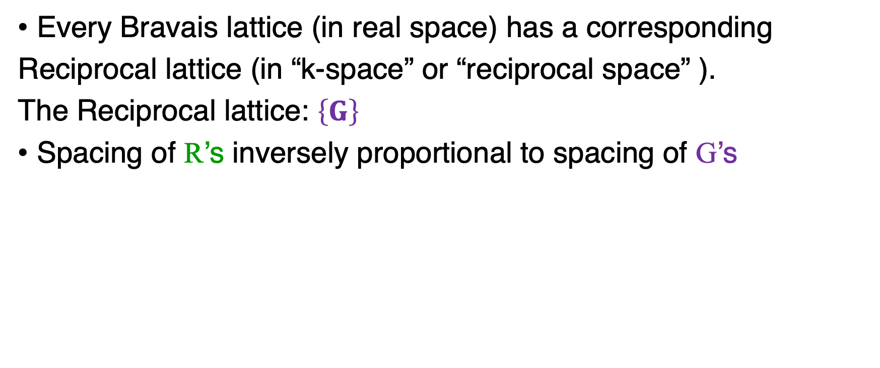
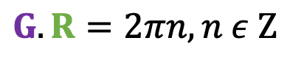
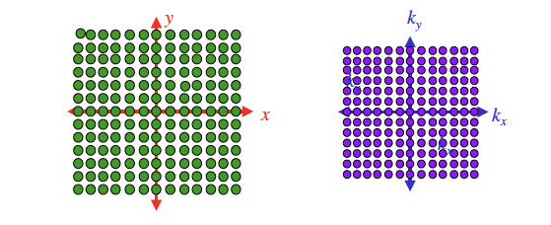
Reciprocal Lattice

Slide 9
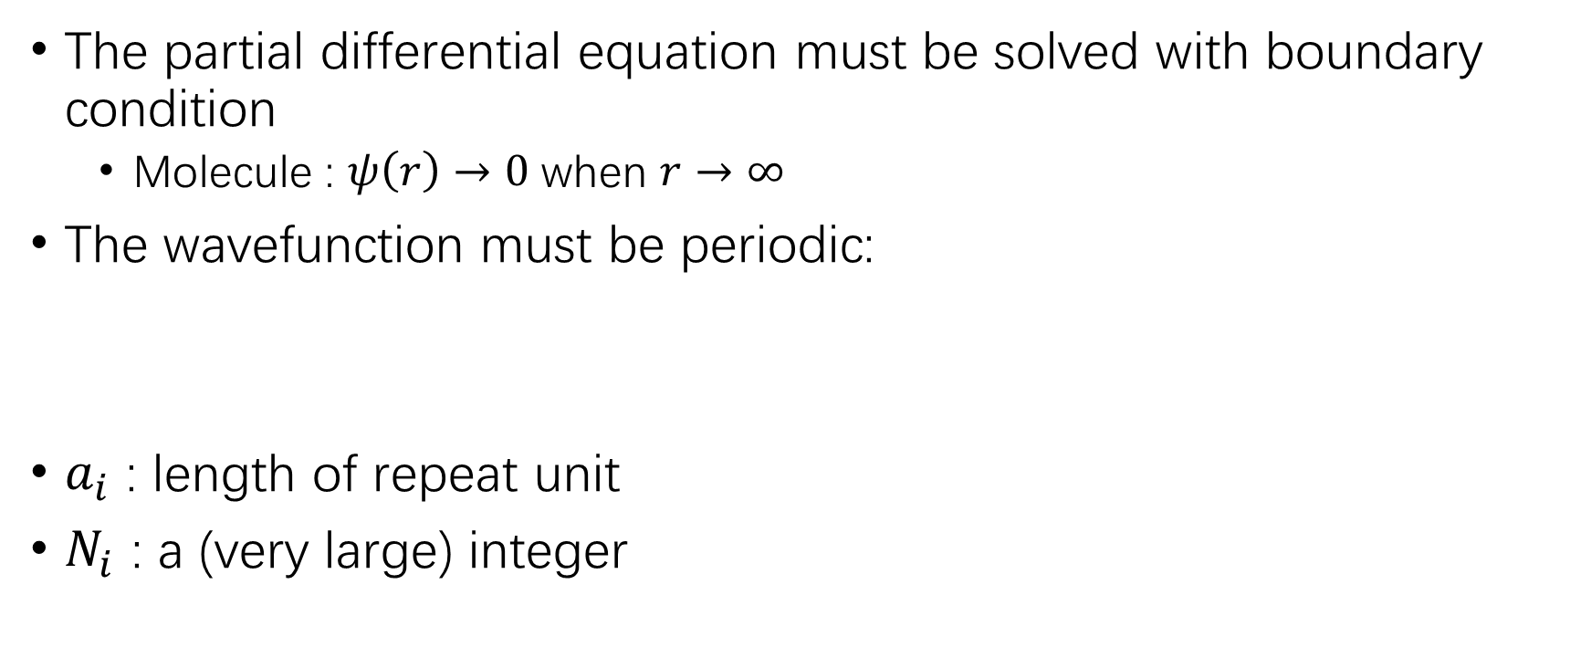
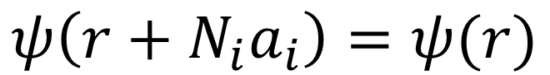
Born-von Karman boundary condition

Slide 10
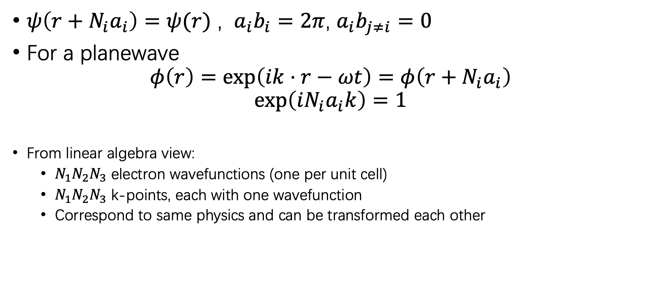
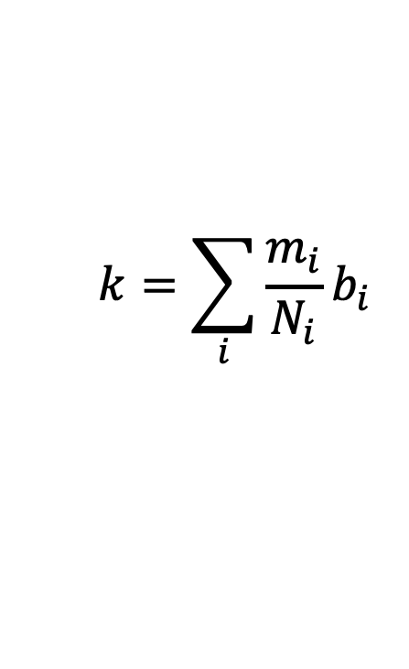
Reciprocal vector
Number of allowed k’s in the 1st (or any other) BZ = Number of unit cells in the crystal, i.e., detd. by size of supercell chosen

Slide 11
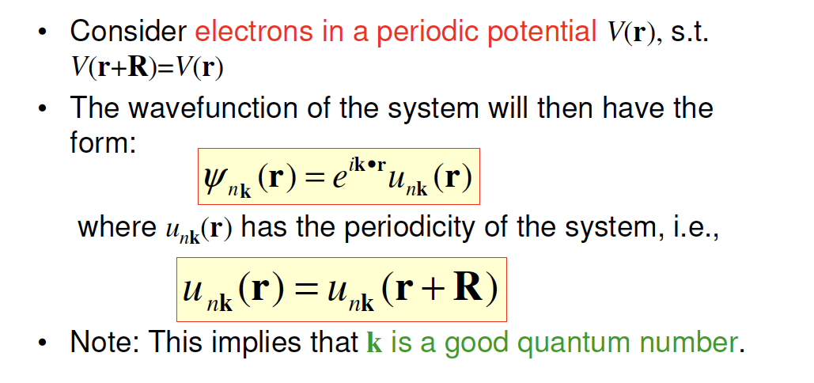
Bloch Theorem
Note that n represents the band index!

Slide 12
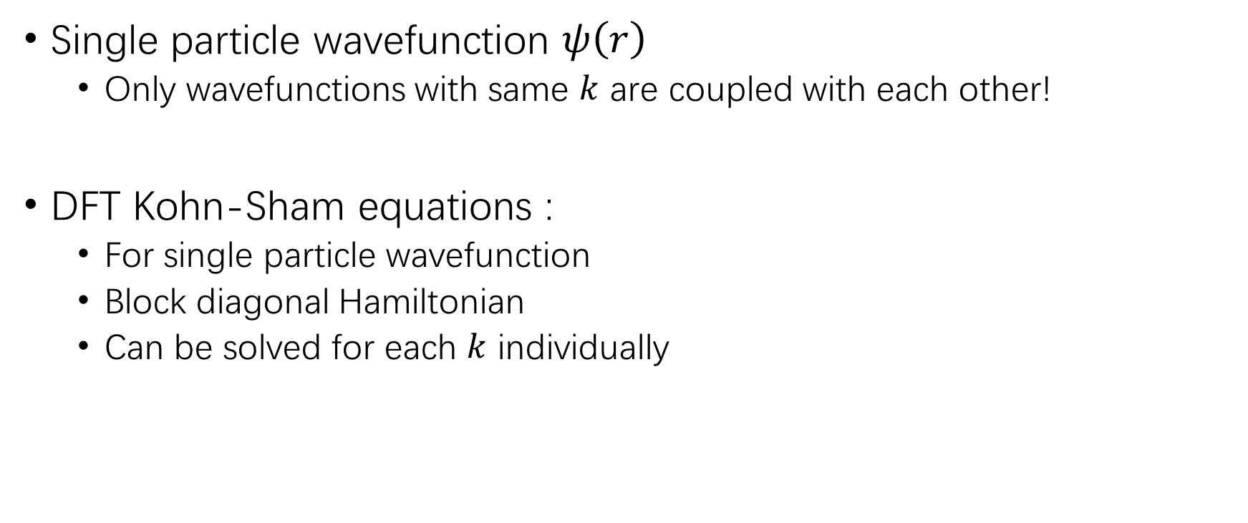
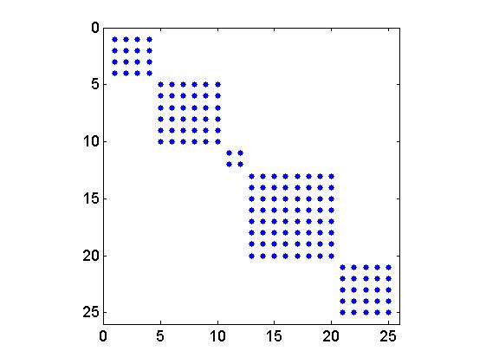
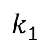
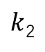
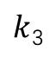
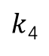
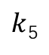
Bloch theorem and DFT
https://www.mathworks.com/matlabcentral/fileexchange/46972-sparse-block-diagonal-concatenation

Slide 13
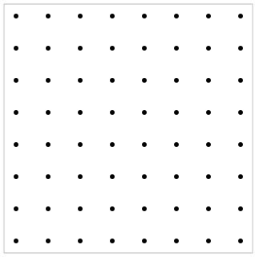
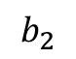
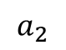
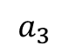
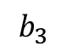
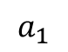
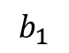
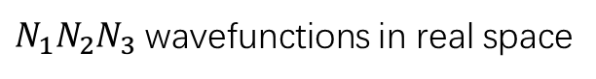
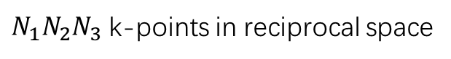
K-point sampling
Continuous in reciprocal space
A few k-points in reciprocal space
Only a few k-points (10¹~10³) are necessary to get most properties of a bulk!

Slide 14
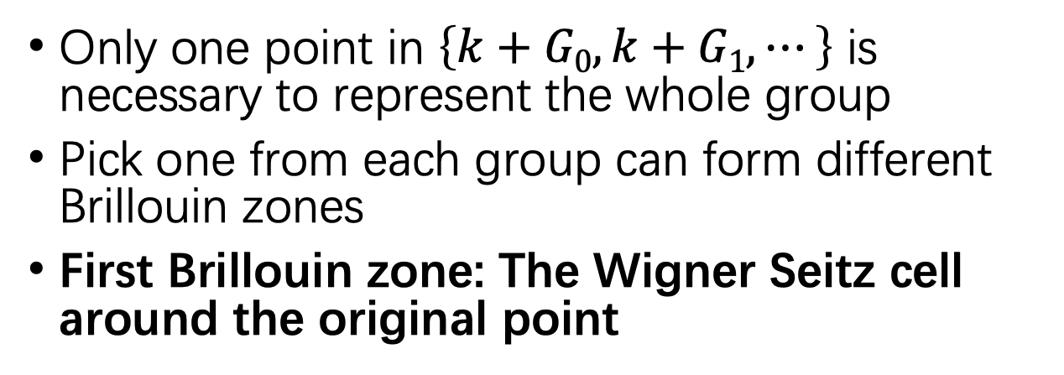
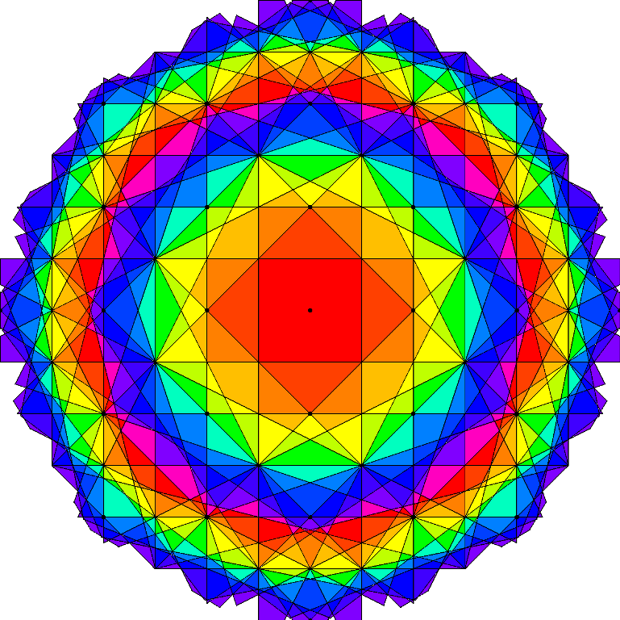
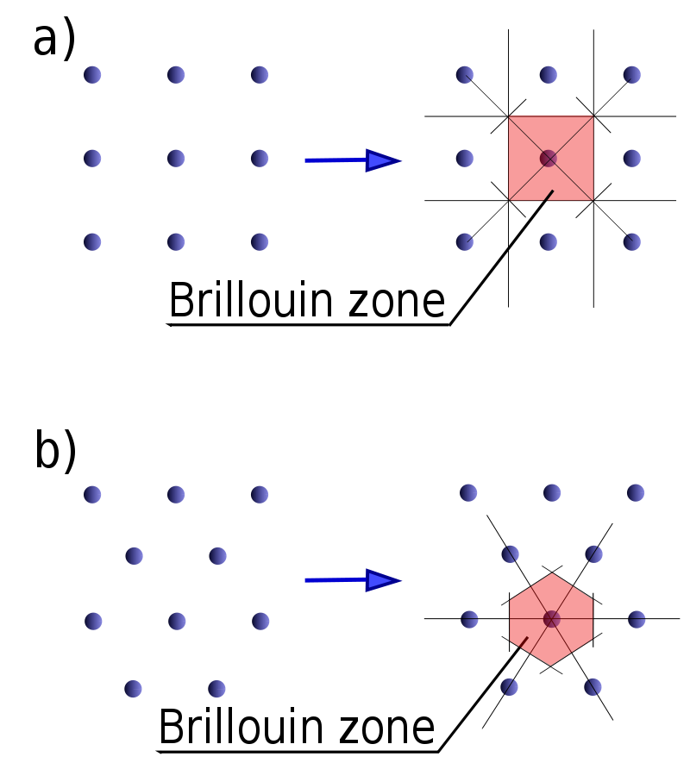
Brillouin zone in reciprocal space
http://skepticsplay.blogspot.com/2011/10/lot-of-brillouin-zones.html
https://en.wikipedia.org/wiki/Brillouin_zone

Slide 15
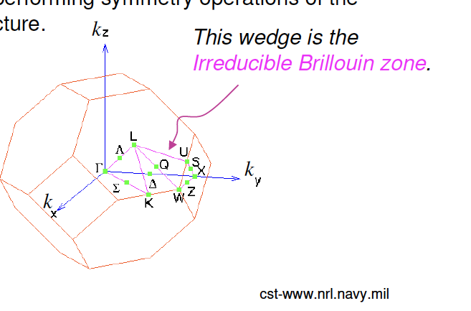
Irreducible Brillouin Zone
Smallest wedge of the 1st BZ such that any wave-vector k in the 1st BZ can be obtained from a wave-vector k in the IBZ by performing symmetry operations of the crystal structure.

Slide 16
Self consistent field (SCF)
ρ_{j}
Atomic Density
No
Finish!
Yes
ρ_{j+1}=ρ_{j}?
V_{H,} V_{xc}
ψ_{i}, ε_{i}
External potential

Slide 17
Self consistent field (SCF) with k-points
ρ_{j}
Atomic Density
No
Finish!
Yes
ρ_{j+1}=ρ_{j}?
V_{H,} V_{xc}
ψ_{i}, ε_{i} (k₁)
Sum
ψ_{i}, ε_{i} (k₂)
External potential
ψ_{i}, ε_{i} (k₂)

Slide 18
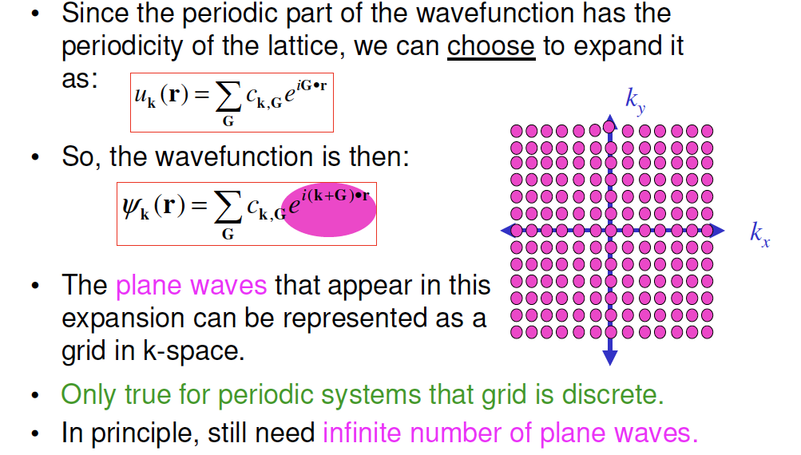
Plane Wave Expansion of Wavefunction

Slide 19
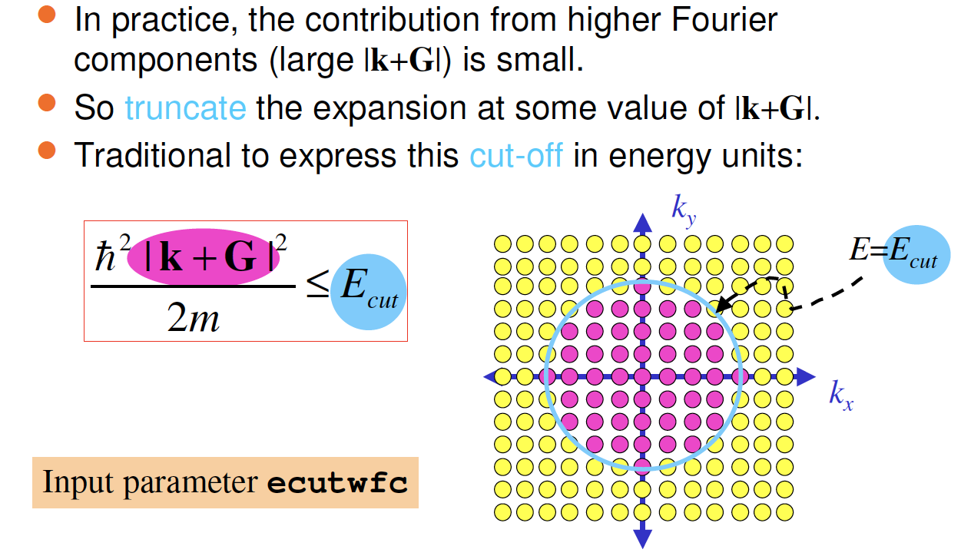
Truncating the Plane Wave Expansion

Slide 20
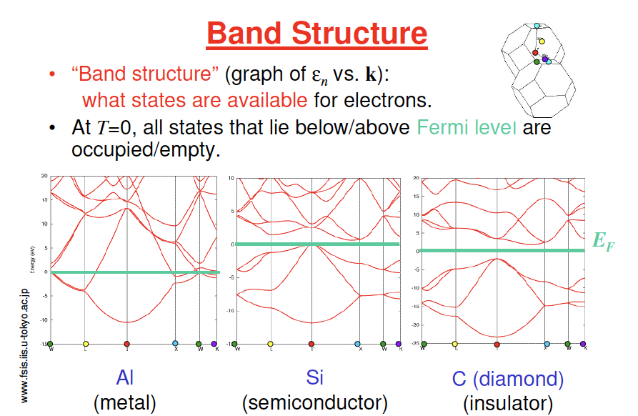

Slide 21
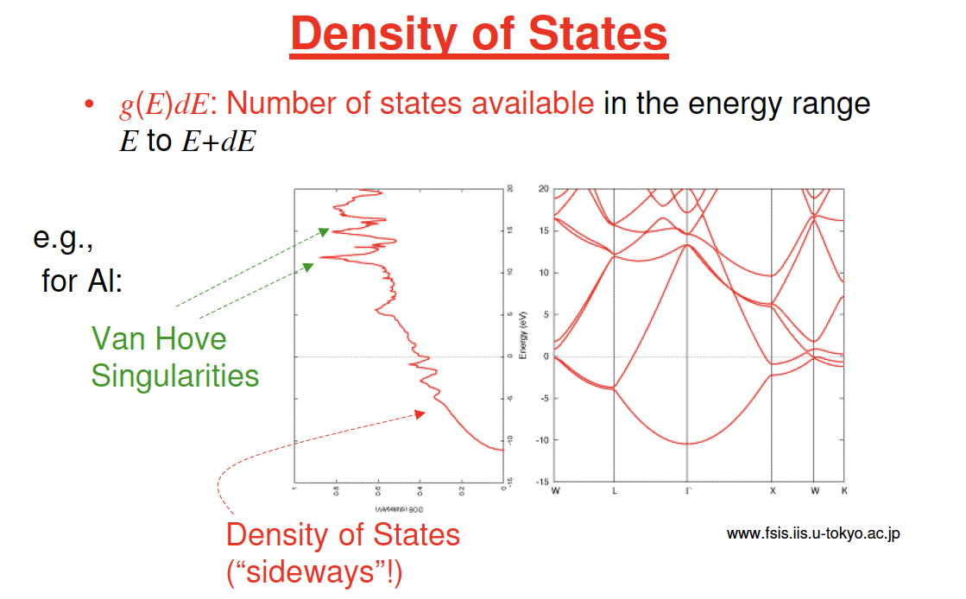
dg(E)/dE diverges

Slide 22
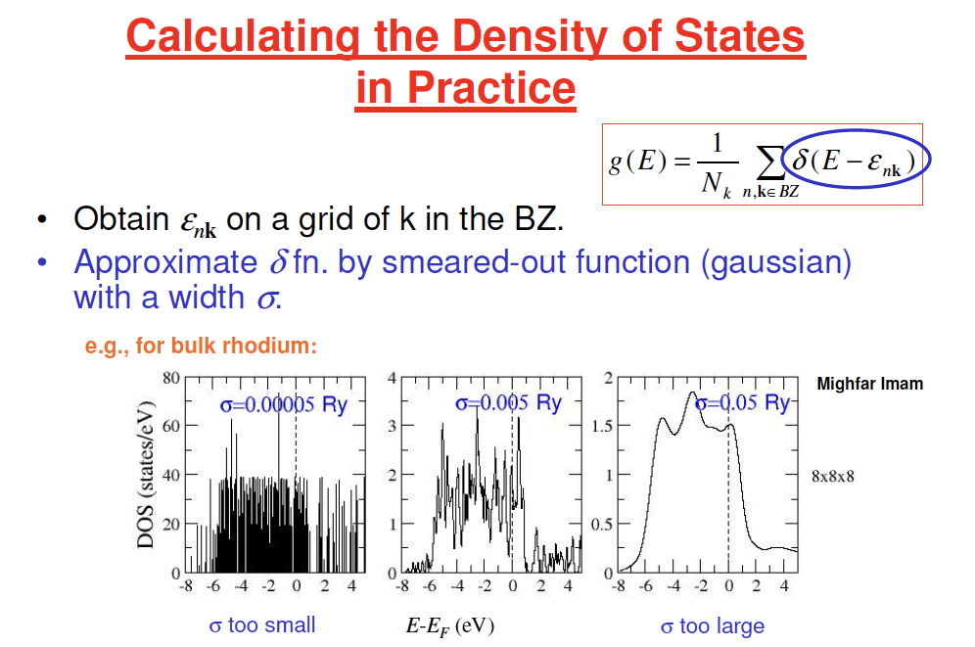

Slide 23
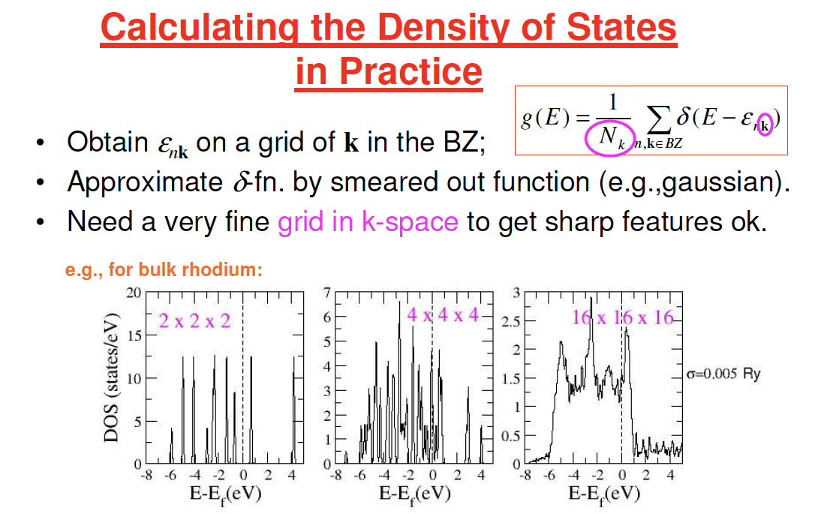

Slide 24
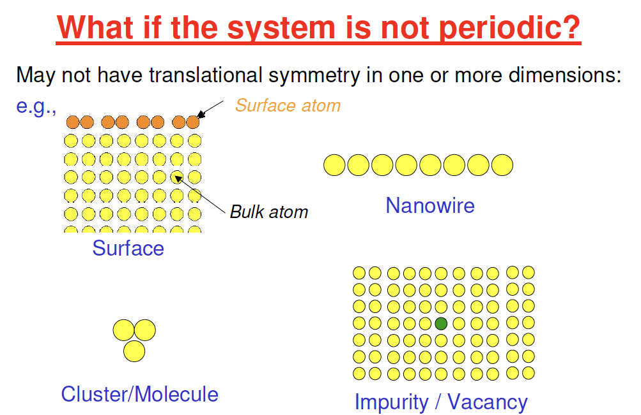

Slide 25
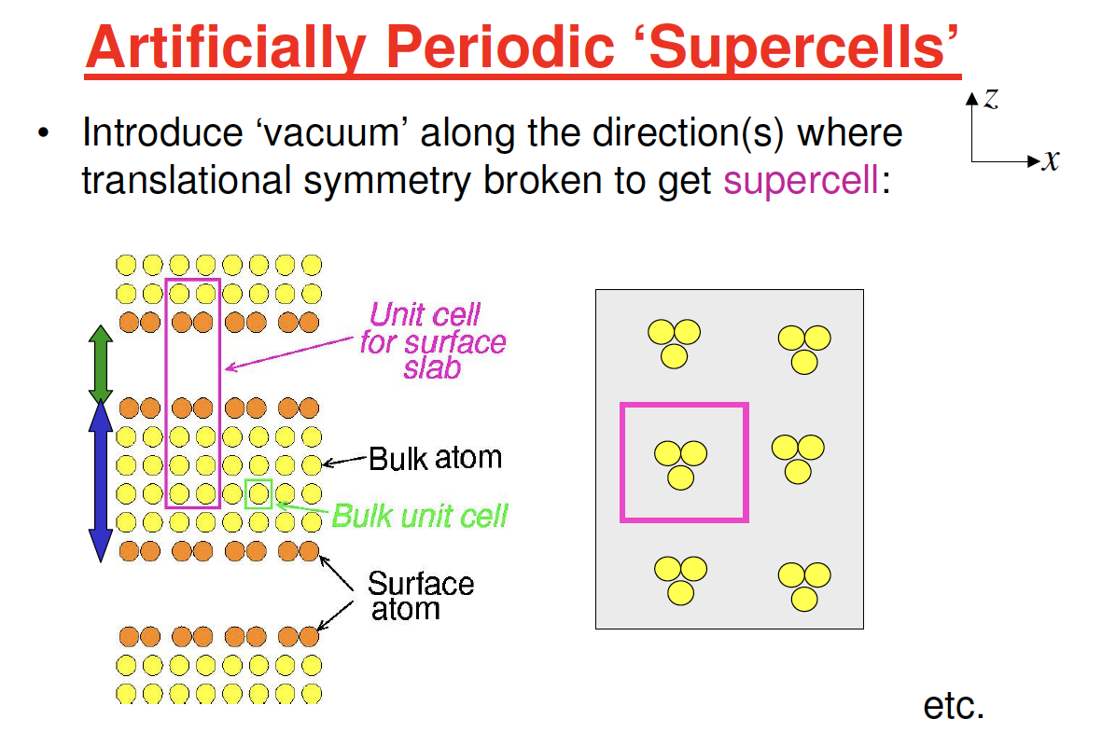

Slide 26
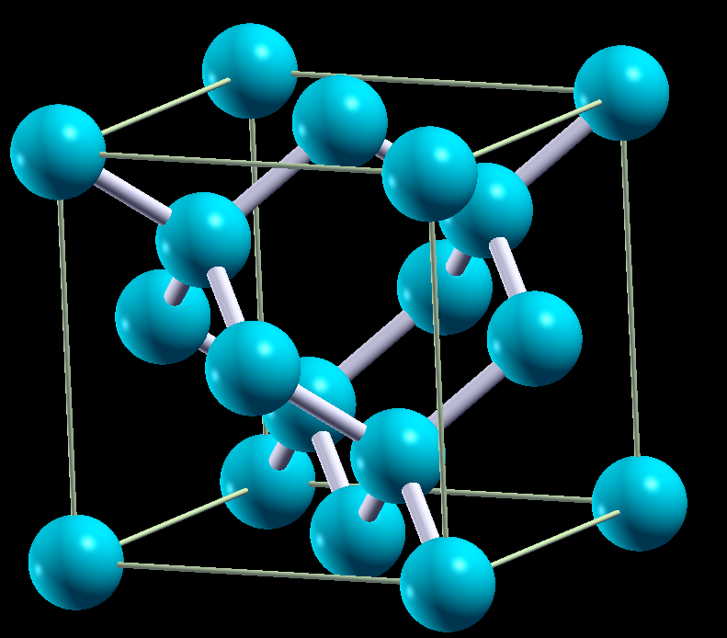
Example: Si bulk
FCC lattice
2 atoms in primitive cell
Each Si bonded with 4 Si
Band structures: eigenvalues at each k-points
Band gap (direct or indirect)
Density of states: number of states at given energy

Slide 27
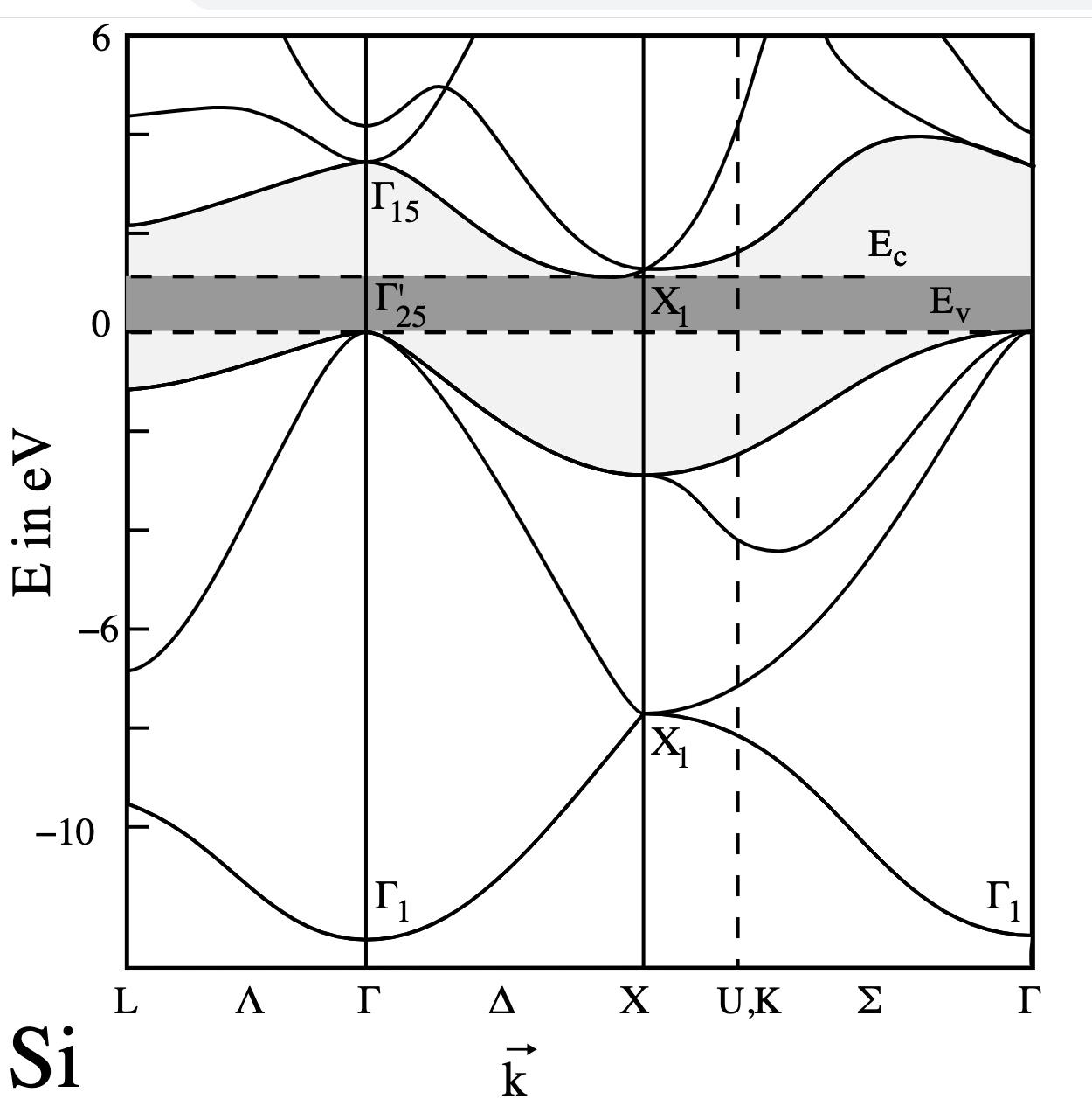
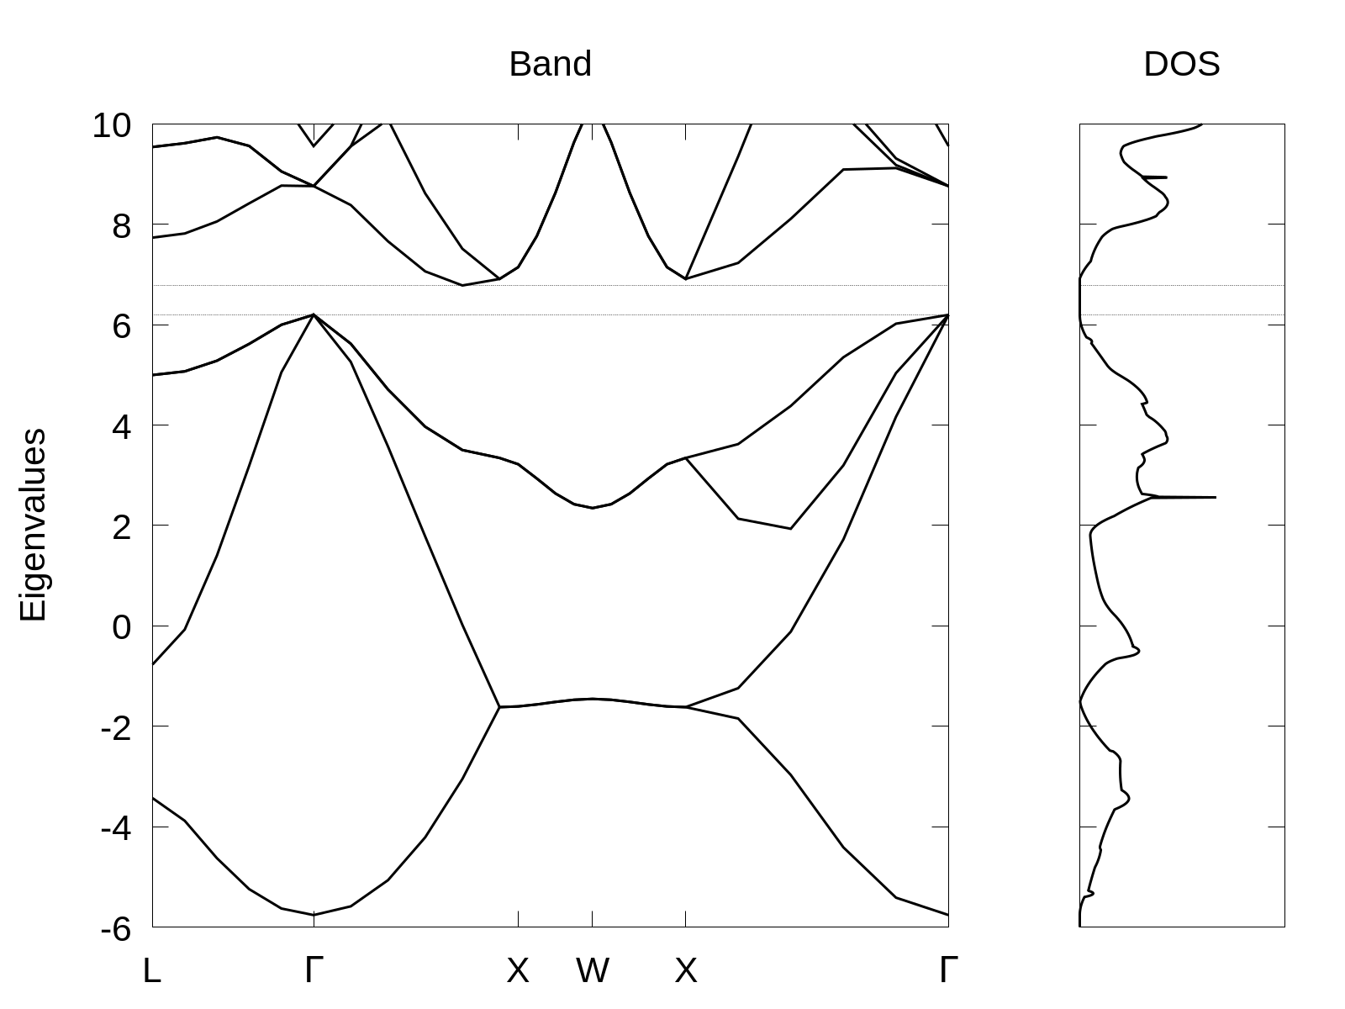
Experimental Si Band structure
Calculated Si Band structure

Slide 28
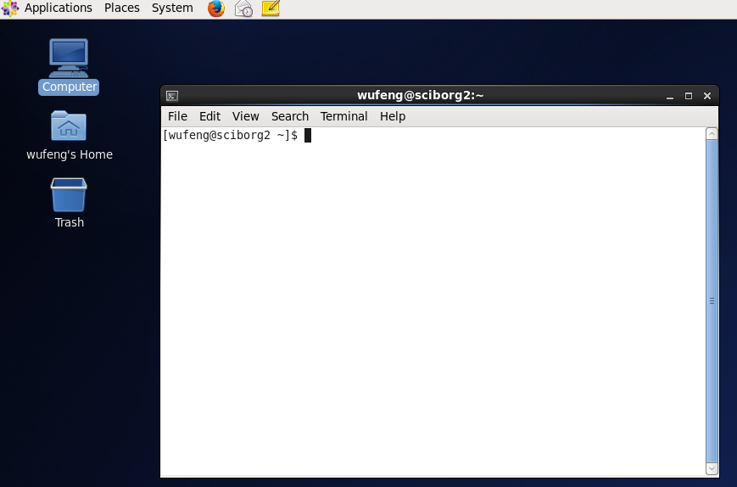
Practice in terminal
Top left :Applications – System Tools – Terminal
Type commands and press enter to run commands in terminal
Run following commands one by one to start:
mkdir l2-si
cp /srv/input_si.zip l2-si
cd l2-si
ls
unzip input_si.zip
cd input
xcrysden –pwi scf.in
Opened terminal

Slide 29


FCC band structure
Special k-points
Xcrysden: Menu-Tools-k-path
https://en.wikipedia.org/wiki/Brillouin_zone

Slide 30
Tasks
Run a scf calculation to get charge density pw.x < scf.in > scf.out
Run a nscf calculation to get eigenvalues on special k-points pw.x < nscf.in > nscf.out
Run bands.x and plotband.x to generate data files to plot bands.x < bands.in > bands.out plotband.x < plotband.in > plotband.out
Run a nscf calculation for better density of states plot pw.x < nscf-dos.in > nscf-dos.out
Run dos.x to generate data files to plot dos.x < dos.in > dos.out
Alternatively, run: chmod +x run.sh after finish: ./run.sh
Plot bandstructure and DOS gnuplot –persist plot.v4.gnu

Slide 31

Run SCF
‘scf’ for self-consistent-field
set files/folder to read and write and what to write
10.26 Bohr (5Å) FCC cell
2 atoms and 1 types of atoms (Si)
basis set size of wavefunction
Species: Pseudo potentials filename
Position of 2 atoms
6x6x6 K-points

Slide 32

Run NSCF for band structure
Non-self consistent field: compute eigenvalues and wavefunctions from fixed charge density (no update)
Including more bands to plot
A list of special k-points
5 points along each line

Slide 33

Run NSCF for density of states
Non-self consistent field: compute eigenvalues and wavefunctions from fixed charge density (no update)
Specific to make DOS looks better
More k-points for better looking DOS and preserve fine DOS structures
(In this example only 6x6x6 for speed)

Slide 34
Band structure and DOS
Experimental band gap: 1.1eV, indirect
DFT band gap problem: always underestimate gap, 40% to no gap

Slide 35
Not in class

Slide 36

Bloch theorem

